Slide 1

Our refreshed identity

Slide 2
A new brand promise
Possibility
unlimited
Notes:
Our new brand promise is possibility unlimited.
At the heart of this is the idea of potential and how the British Council helps people to unlock that potential through the power of what we do best.​
It’s been carefully crafted to reflect the breadth our or work – it begins to reflect the shifts we need to make:​
​
Purpose driven​
Bold and inspiring​
Inclusive and aspirational​
Speaks to our impact​
Unifying rallying cry​

Slide 3
Brand promise supporting narrative
There’s huge potential in all of us; to discover, to connect, to achieve, to make a difference. We help individuals, organisations and countries unlock that potential and realise their ambitions by opening up new possibilities.
For almost 100 years we’ve been sharing what the UK has to offer with the world. We create environments where collaboration and trust thrive, bringing people together to share knowledge, spark new conversations and connect in new ways.
Through the power of language, learning, and creativity we grow partnerships, broaden horizons and expand opportunities.
From the UK to the world, and from the world to the UK, together we have the power to dream bigger and shape a more peaceful and prosperous future for all.

Slide 4
Possibility unlimited
Multiple interactions
Interwoven moments
Eclectic combinations
The bringing together of people, organisations and nations

Slide 5
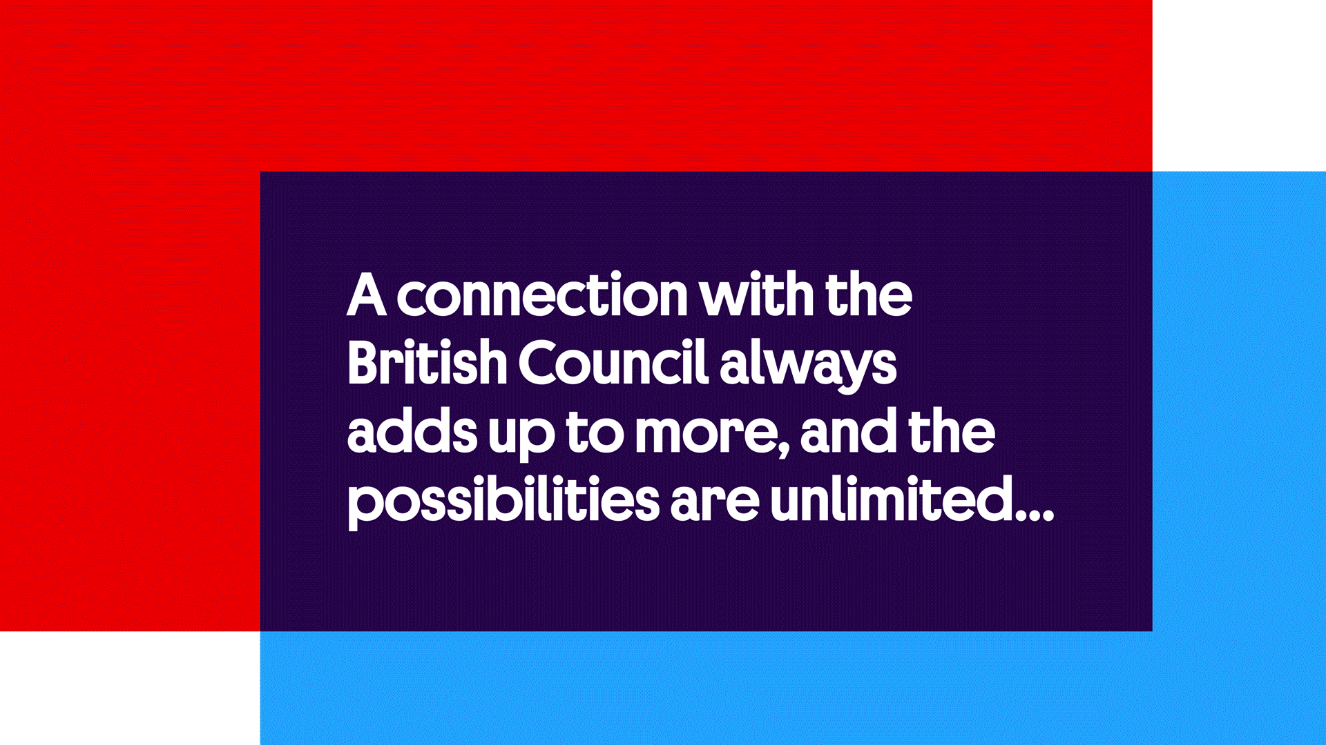

Slide 6
Distinctly British (Council)
Ever-changing
Diverse
Human touch
Flexible tone

Slide 7
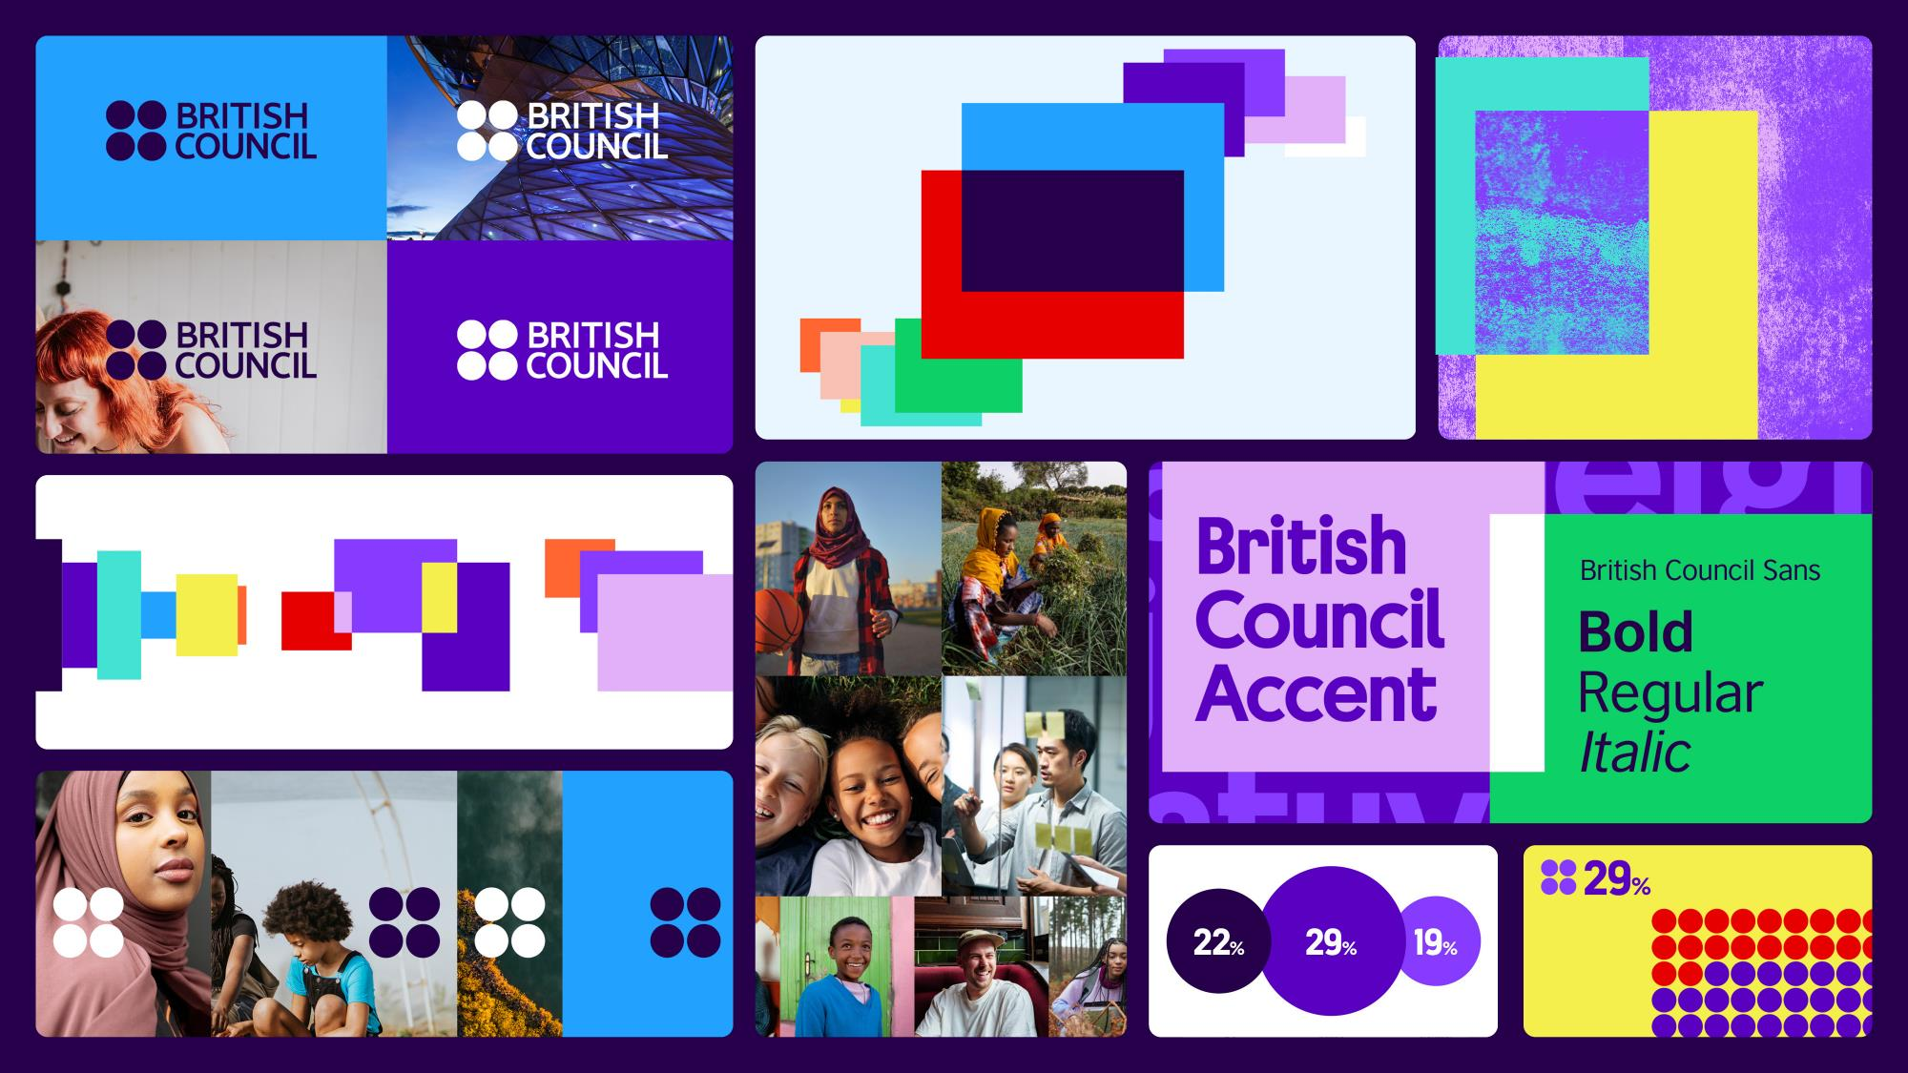

Slide 8


Slide 9
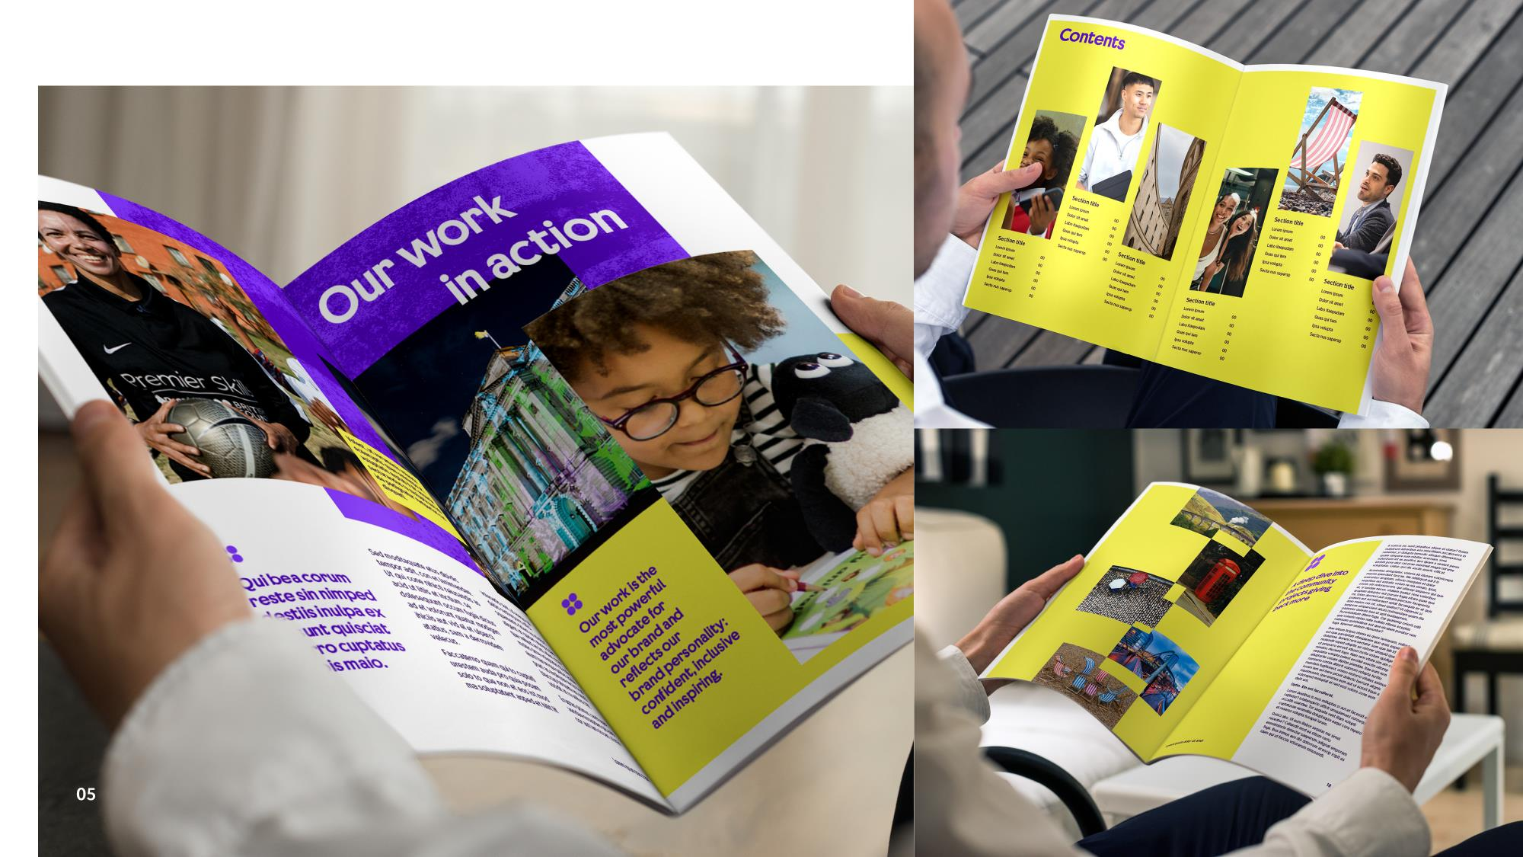

Slide 10
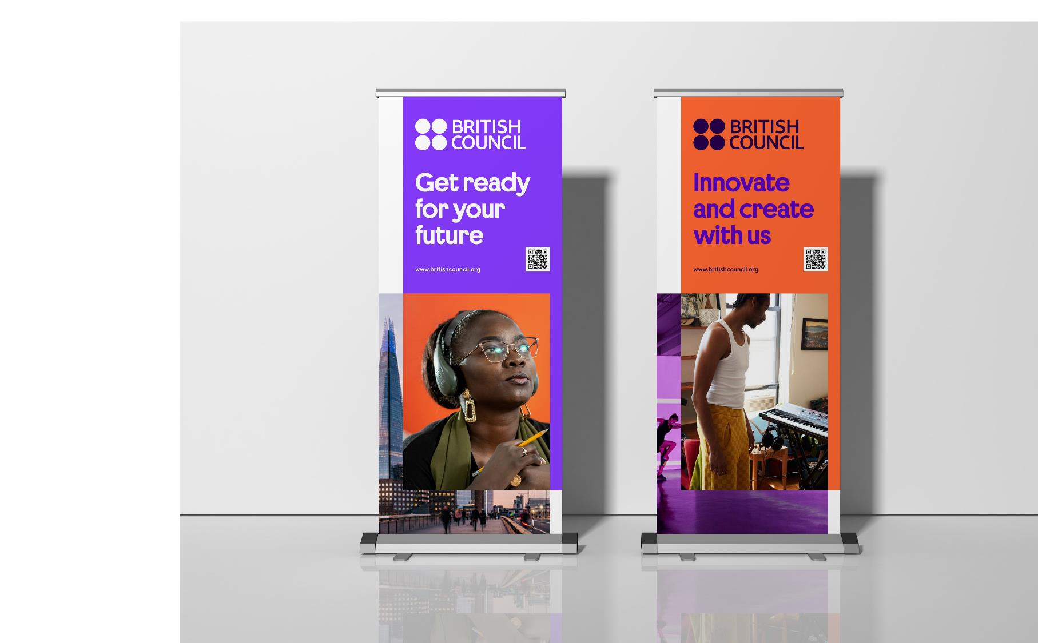

Slide 11
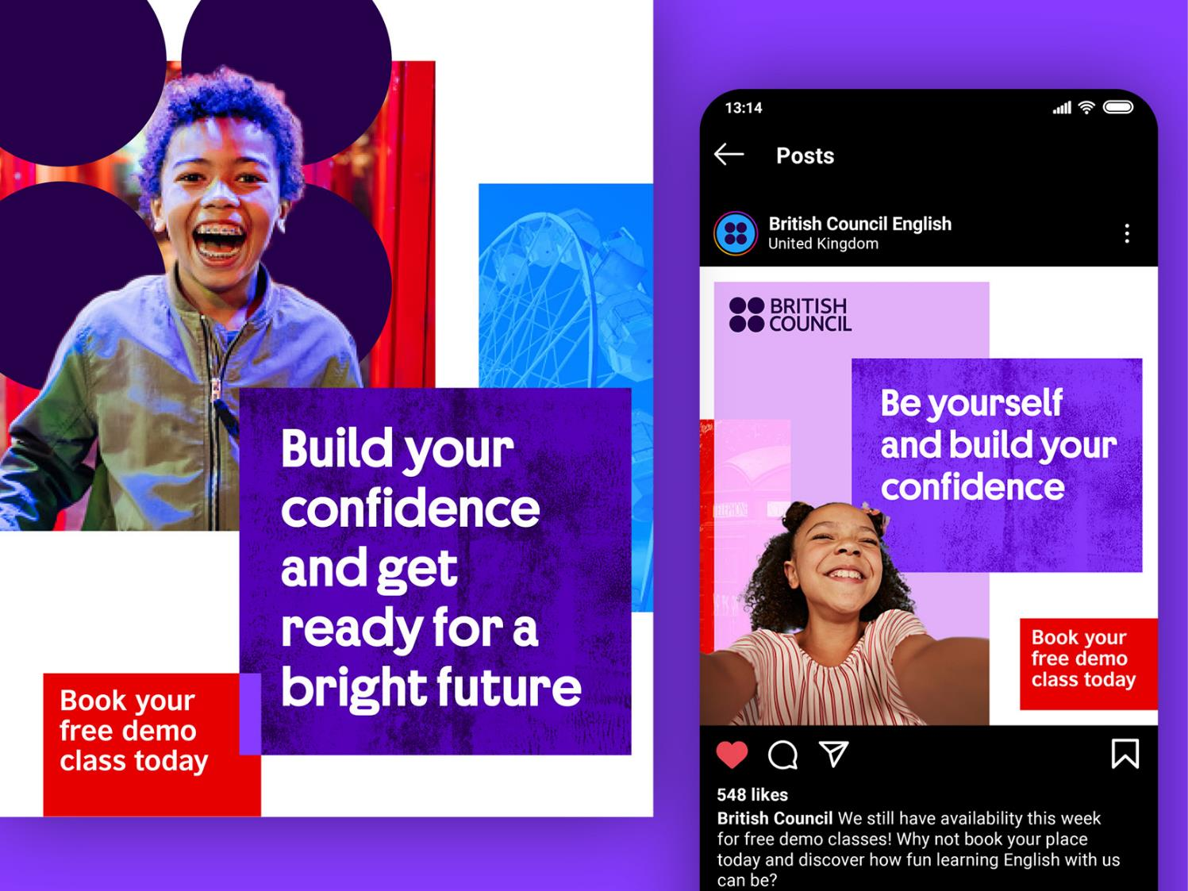

Slide 12
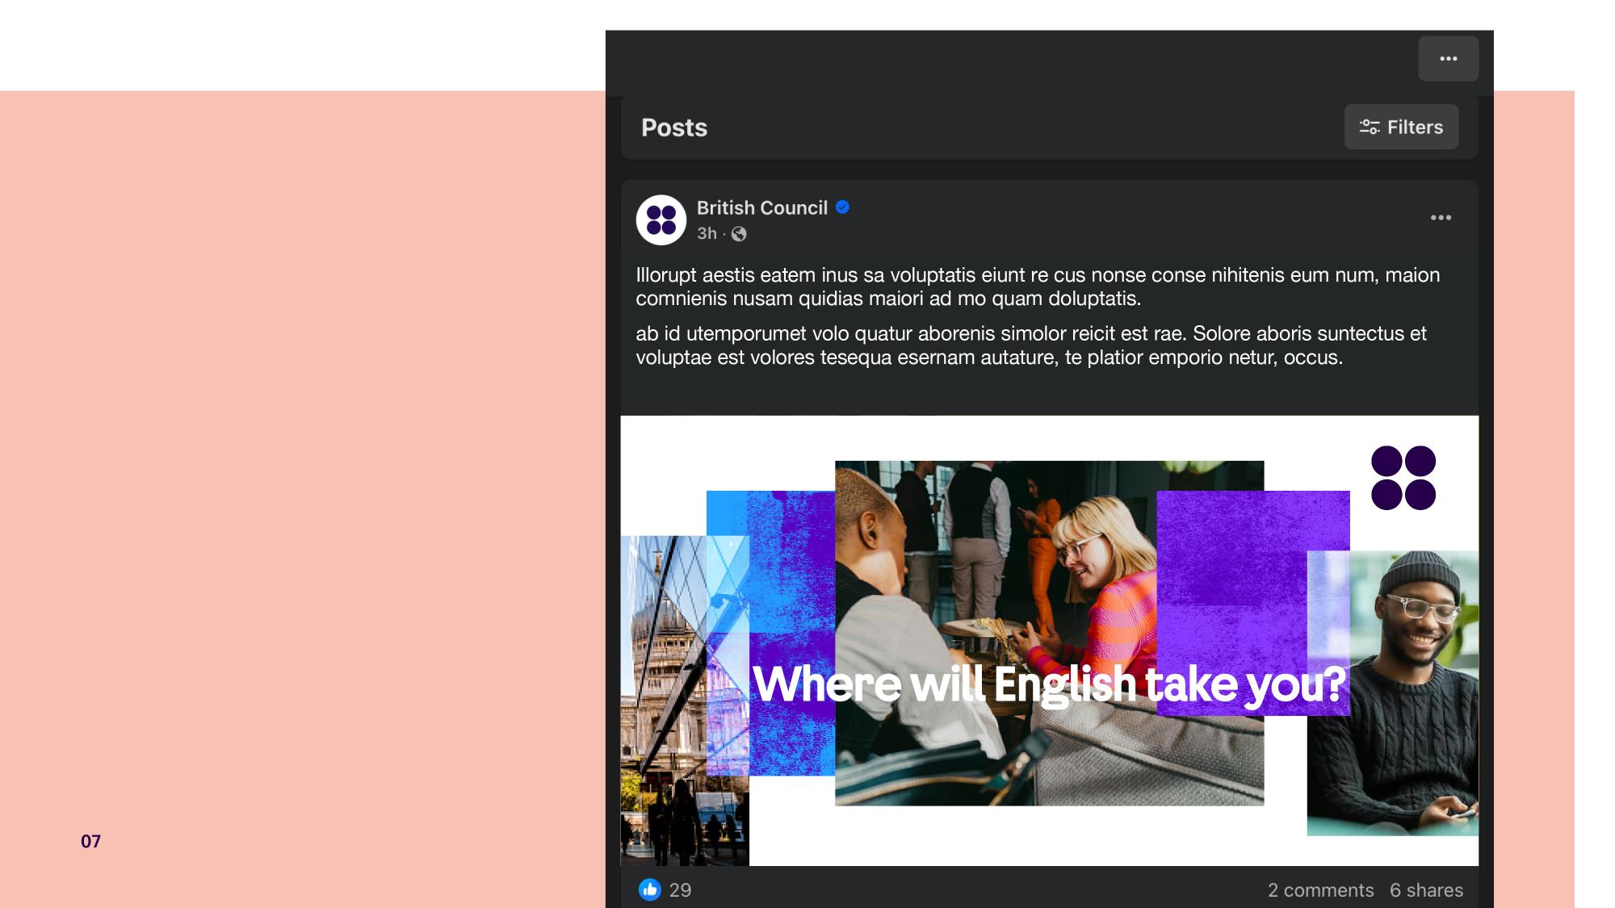

Slide 13


Slide 14
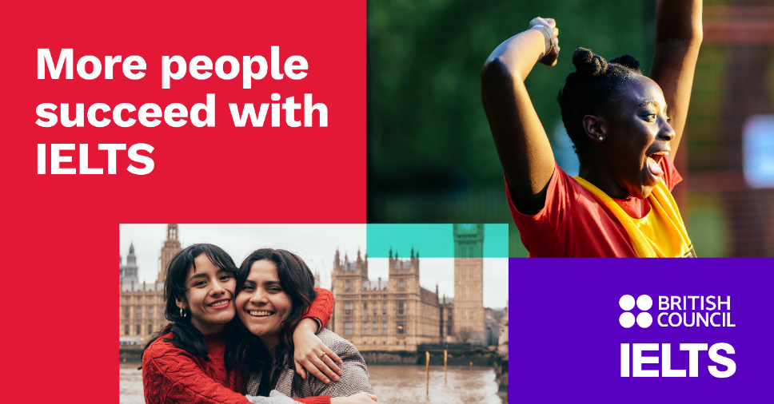
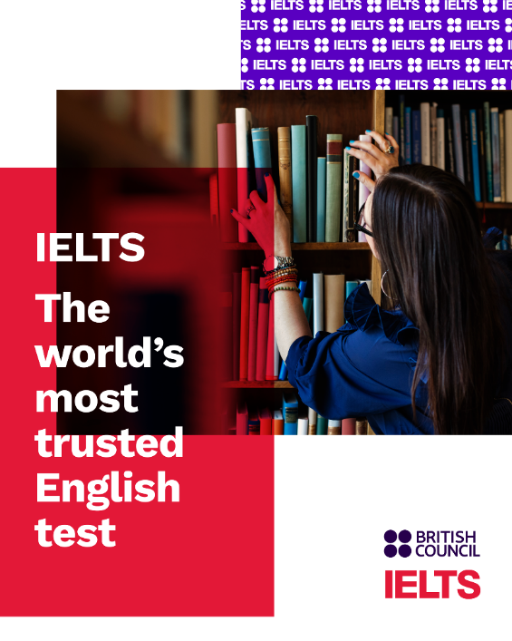

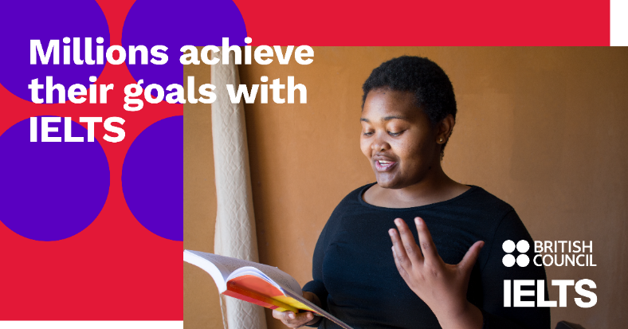

Slide 15

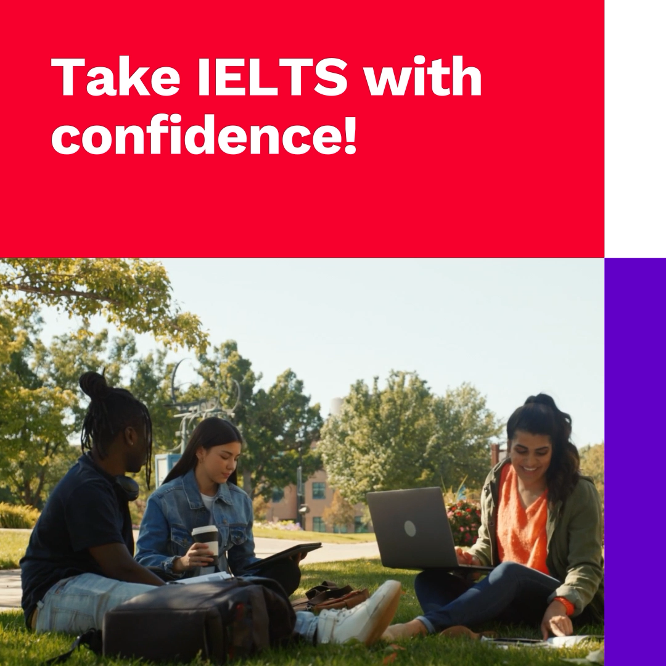
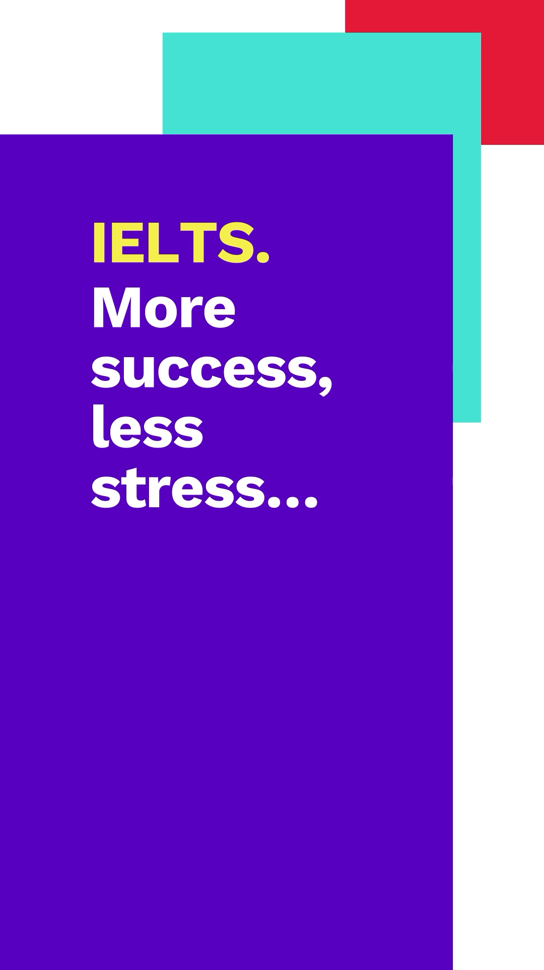

Slide 16
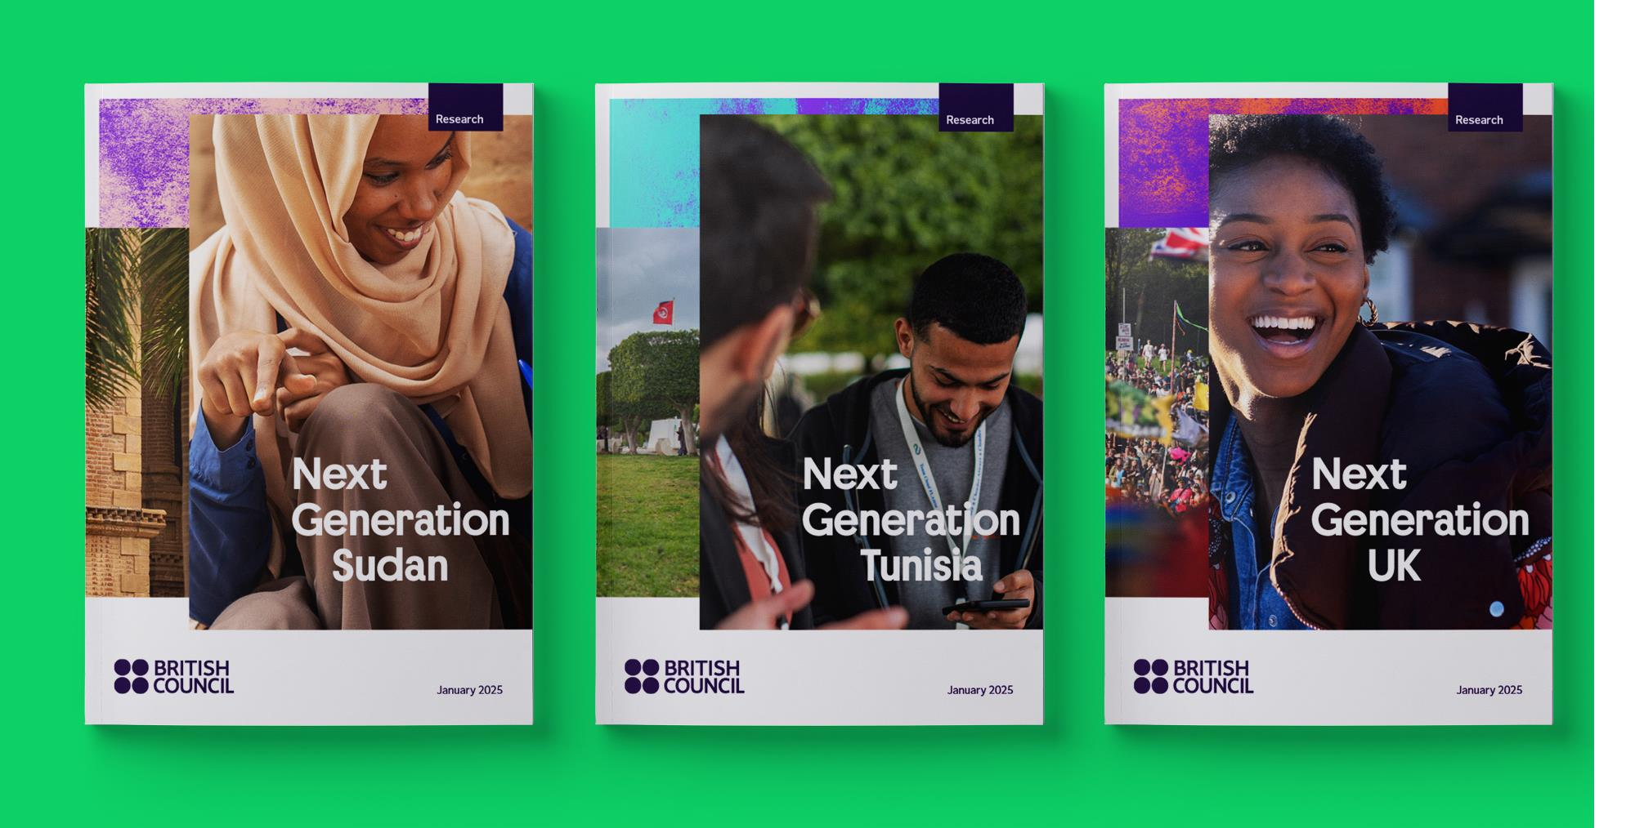

Slide 17
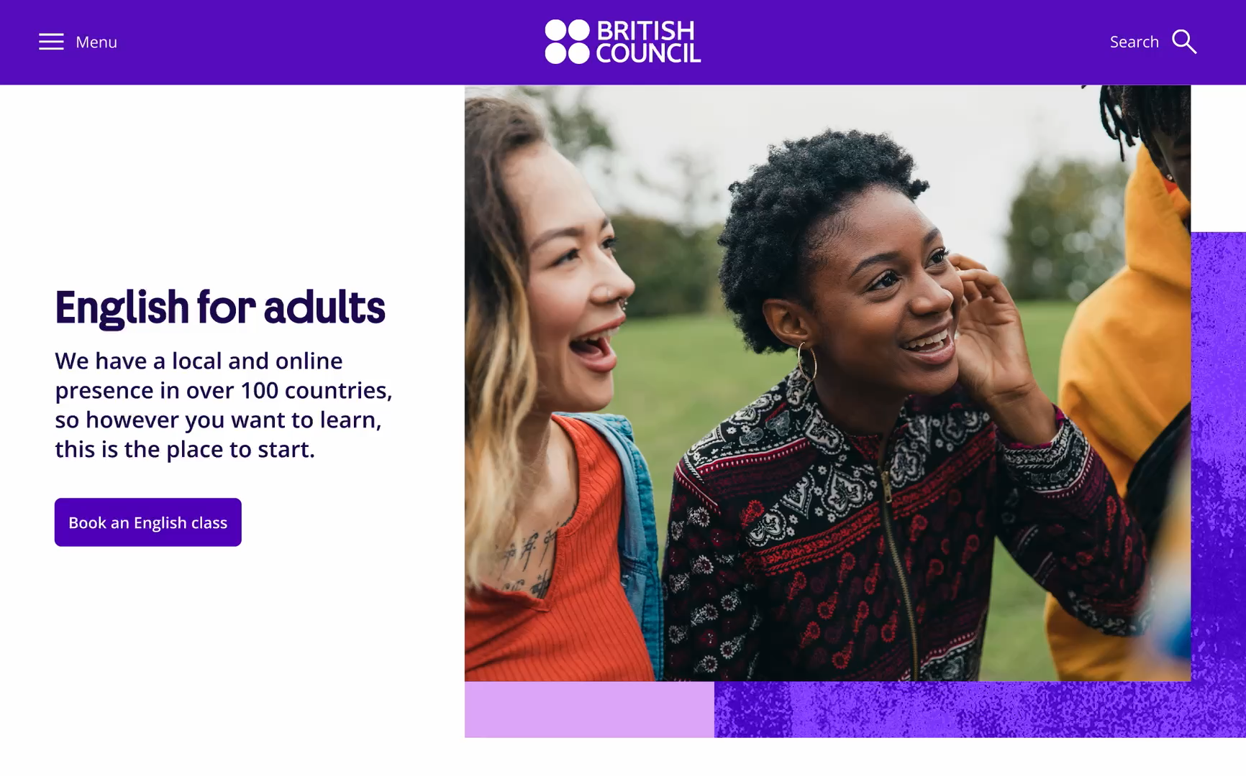

Slide 18
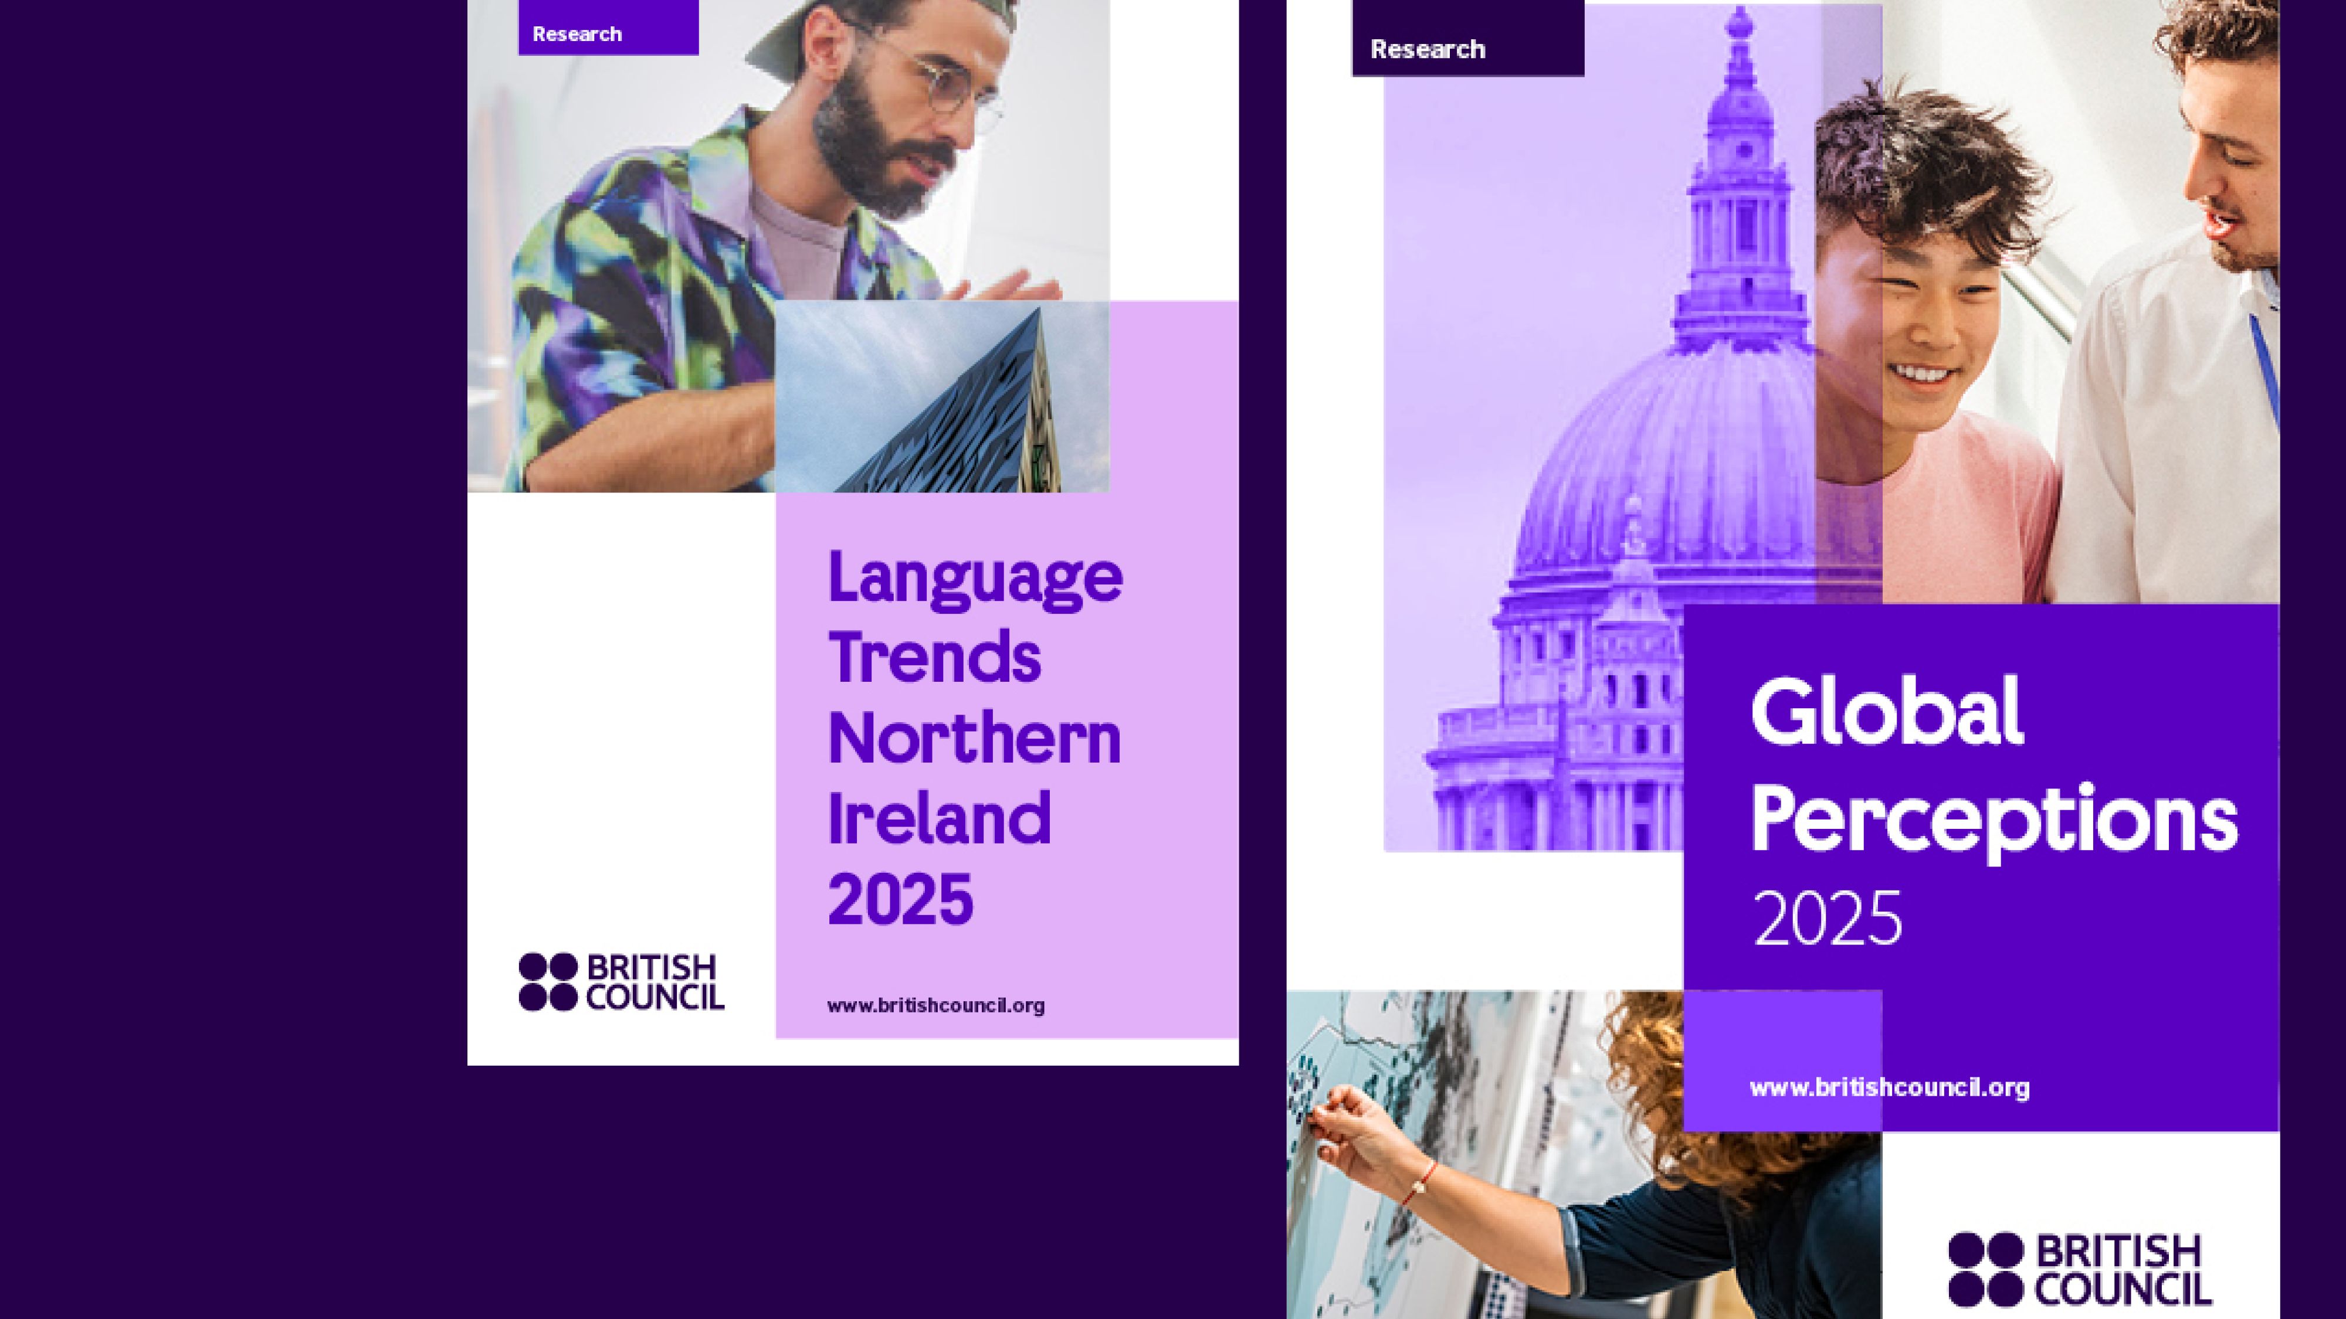

Slide 19
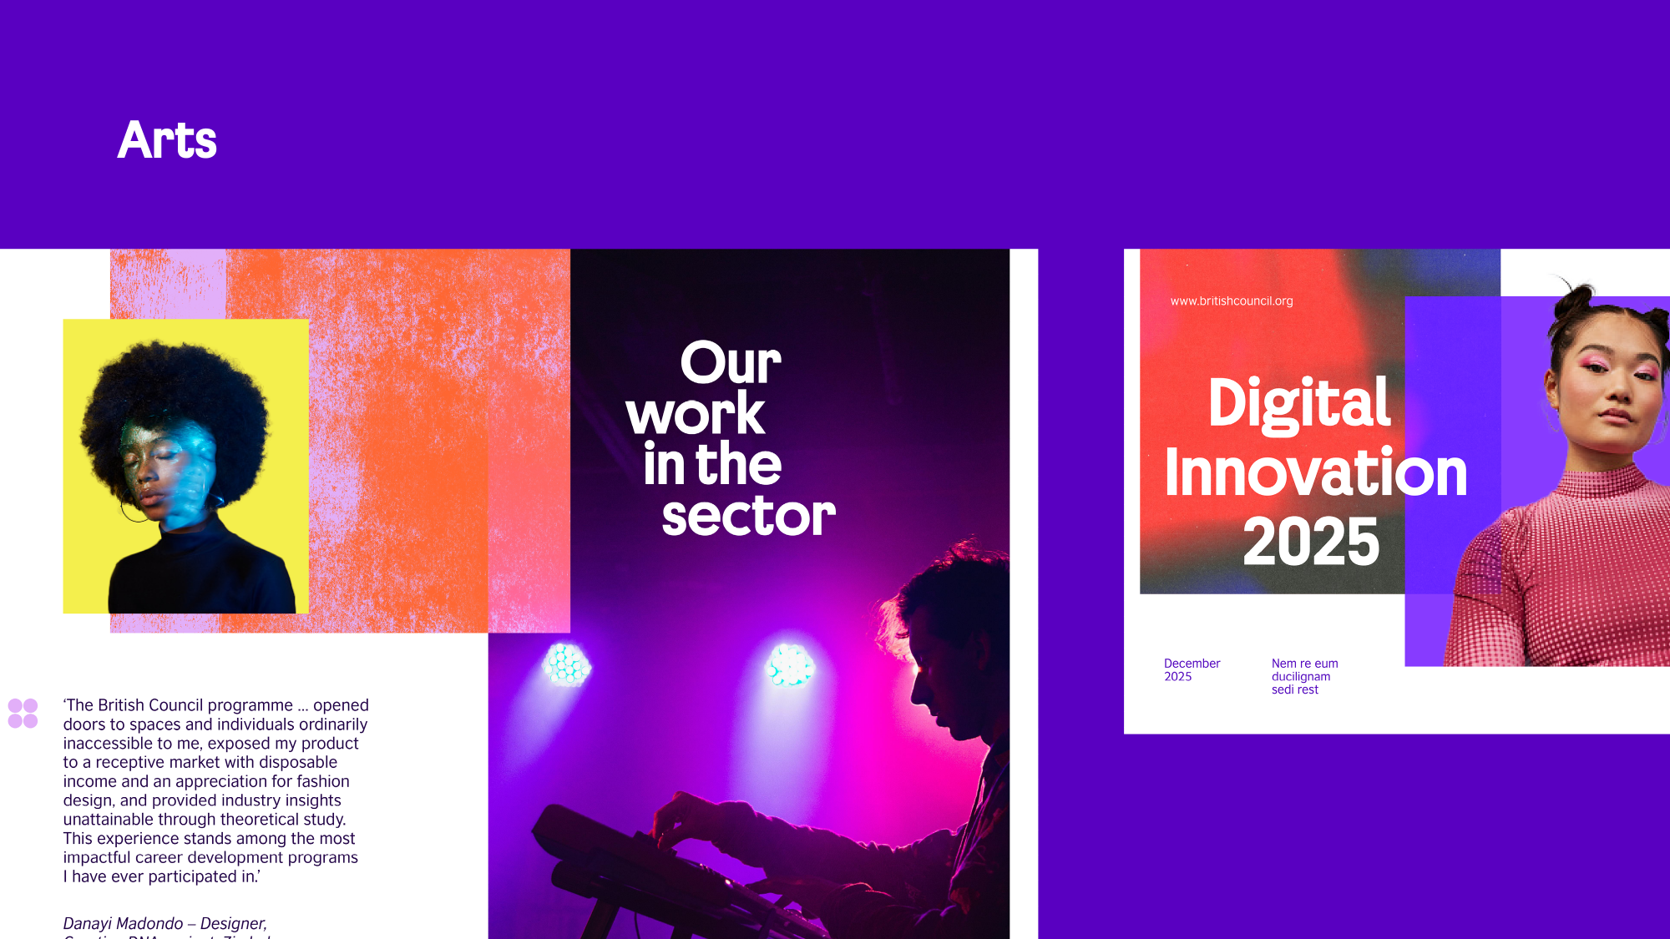

Slide 20
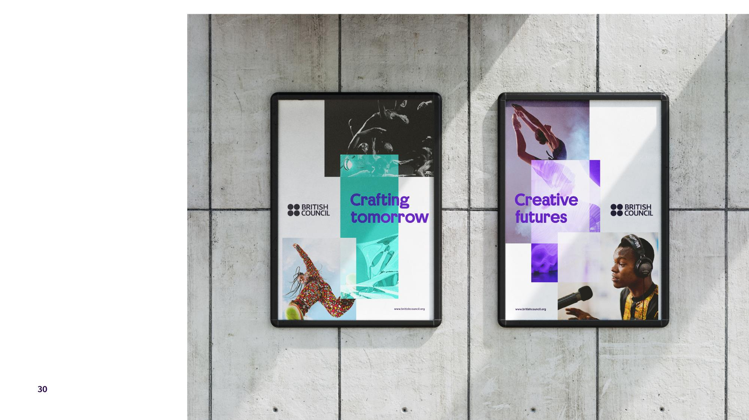

Slide 21
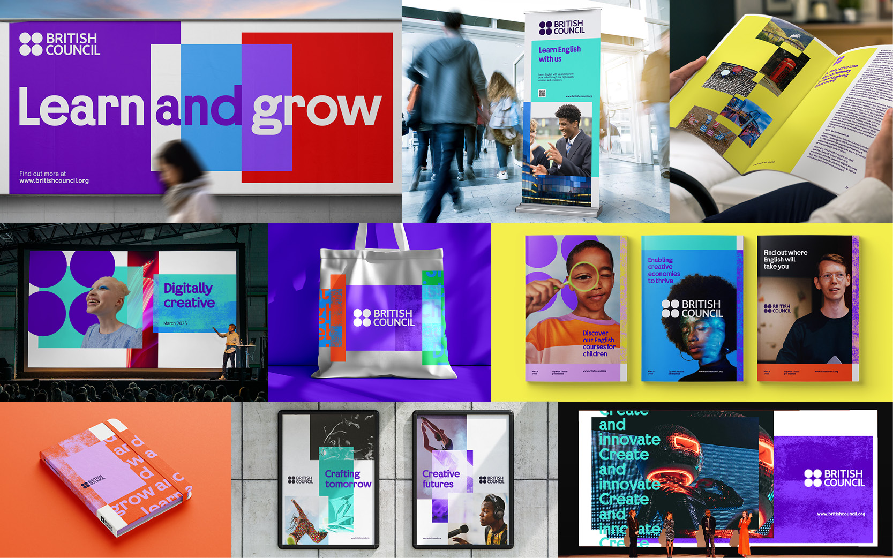


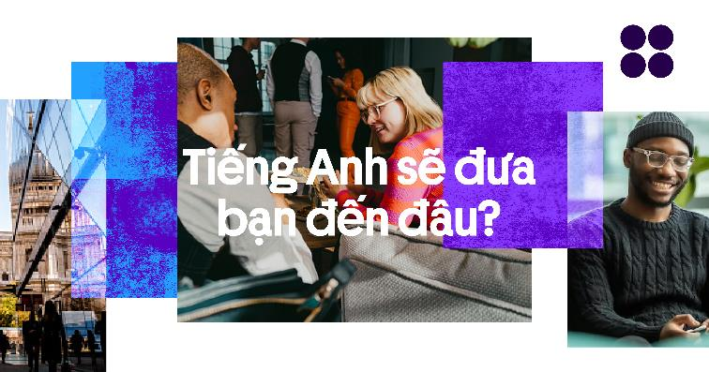

Slide 22
Providing what’s needed
Modernity
Cohesion
Vibrancy, energy and fresh feel of ONE British Council
Behaviours, design principles, and core assets
Agility
Distinctiveness
Flexibility of design system, unique variety of content and motion principles
Logo, asset toolkit, indigo range and British quirk

Slide 23
Thank you

